Slide 1

Web Scraping Project on the Puma Website

Slide 2
Introducing to web scraping
Web scraping is a Web scraping is a technique used to technique used to extract data from websites. This project focuses on the Puma website, aiming to gather product information to analyze trends and pricing.

Slide 3
Objectives of the Project
The main objectives of this project include identifying key objectives of this project include identifying key data points such as product names, prices and discount .

Slide 4
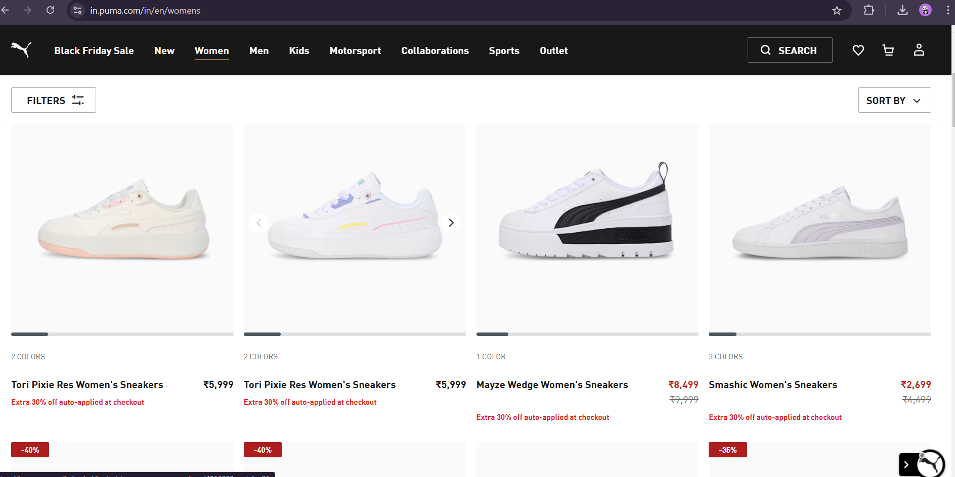
Understanding the Puma Website Structure
To effectively scrape data, it's crucial to understand the Puma website's structure. This includes analysing the HTML layout, identifying key elements, and determining the best approach for navigating the site. A clear understanding will lead to more accurate data extraction.

Slide 5
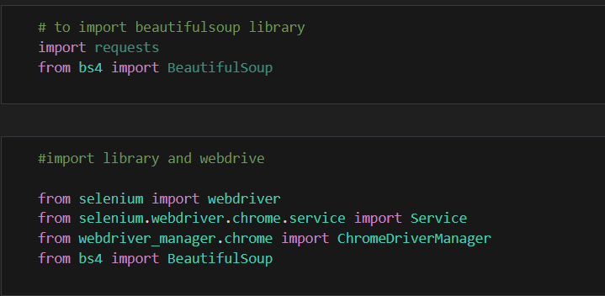
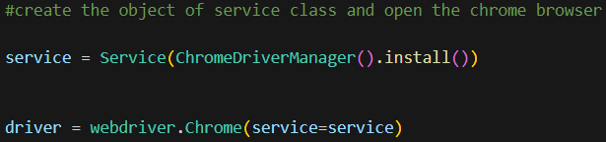
1. Install all the necessary libraries like and import them.
2. create the object of service class to open a Chrome Driver that matches your installed version of Google Chrome.

Slide 6



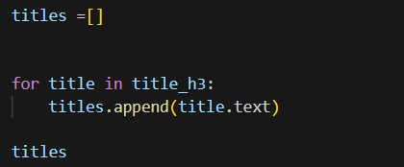
5. extracting the product details
3. navigate to the specified URL
4. Read the code form site

Slide 7

6. Find the length of all the columns to fetch the data
7. Create dataframe to retrive the data

Slide 8

7. Create CSV file

Slide 9
THANK YOU

